Slide 1

Smart Energy Saving System with Automated Room Monitoring
This project introduces a smart energy-saving system that automates room monitoring using IR sensors. It efficiently controls lights and fans based on the number of people present, reducing unnecessary energy consumption. This system is a practical, cost-effective, and eco-friendly solution for smart homes, offices, and public buildings, contributing to a sustainable future.

Slide 2

Project Objectives
1
Automated Occupancy Monitoring
2
Presence-Based Control
3
Optimize Energy Consumption
Control lights and fans based on the presence of individuals in the room.
Develop an automated system for monitoring room occupancy using IR sensors.
Optimize energy consumption in homes, offices, and public spaces.
The primary goal is to create a system that reduces unnecessary energy usage by automatically adjusting lights and fans based on real-time occupancy. This will lead to significant energy savings and promote sustainable practices.

Slide 3





Key Components
Arduino Uno
IR Sensors
7-Segment Display/LCD
Microcontroller board to process sensor data.
Detect entry and exit of individuals.
Displays the count of people inside.
Relay Module
Controls the operation of lights and fan.
The system relies on several key components, including the Arduino Uno for processing data, IR sensors for detecting movement, a display for showing the number of occupants, and a relay module for controlling appliances.

Slide 4
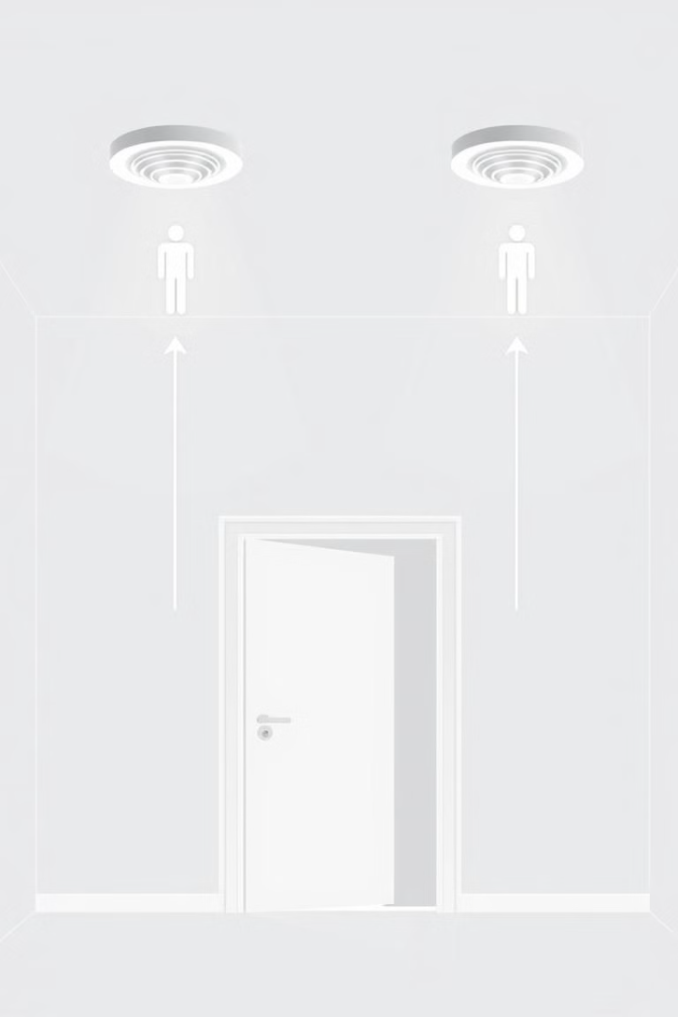




Working Principle
IR Sensor Placement
Two IR sensors are placed at the entrance to detect movement.
Direction Detection
Sensor 1 before Sensor 2 indicates entry; Sensor 2 before Sensor 1 indicates exit.
Occupancy Count
The counter increases for entry and decreases for exit.
Appliance Control
Lights and fan turn ON if the count is 1 or more, and OFF if the count is 0.
The system uses two IR sensors to determine the direction of movement. Based on this, the system increases or decreases the occupancy count, which in turn controls the lights and fan.

Slide 5
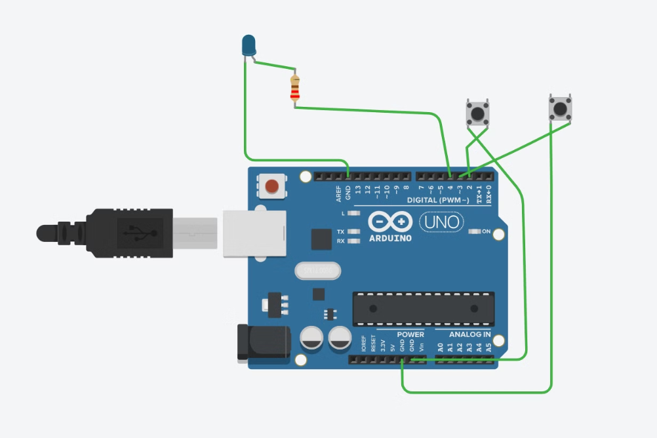
Circuit diagram

Slide 6
Circuit Diagram Explanation
IR Sensors
Relay Module
Detect movement at the door and send signals to Arduino.
Turns the electrical appliances ON/OFF based on the counter.
Arduino Uno
Display (LCD/7-Segment)
Processes input from sensors and controls the relay module.
Shows the number of people inside.
The IR sensors detect movement and send signals to the Arduino Uno, which processes the data and controls the relay module. The relay module then turns the electrical appliances ON or OFF based on the occupancy count, while the display shows the number of people inside.

Slide 7
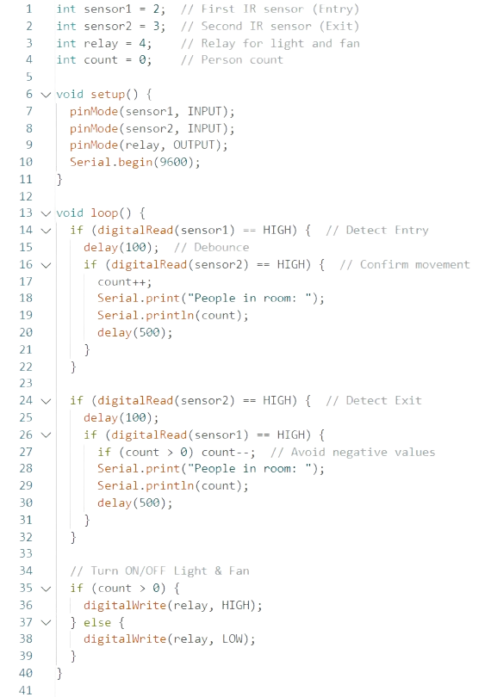
Arduino Code Snippet
int sensor1 = 2; // First IR sensor (Entry)
int sensor2 = 3; // Second IR sensor (Exit)
int relay = 4; // Relay for light and fan
int count = 0; // Person count
void setup() {
pinMode(sensor1, INPUT);
pinMode(sensor2, INPUT);
pinMode(relay, OUTPUT);
Serial.begin(9600);
}
The Arduino code initializes the IR sensors and relay module, reads input from the sensors to determine entry and exit, and controls the relay to turn the lights and fan ON or OFF based on the occupancy count. The code also includes debouncing to avoid false readings.

Slide 8

Applications
Smart Homes
Automates lighting and fan control for energy efficiency.
Offices & Commercial Buildings
Reduces electricity wastage in unoccupied spaces.
Educational Institutions
Ensures energy efficiency in classrooms and lecture halls.
Public Spaces
Automatically manages lights and appliances in public areas.
This system can be applied in various settings, including smart homes, offices, educational institutions, and public spaces, to automate lighting and fan control, reduce electricity wastage, and ensure energy efficiency.

Slide 9








Advantages
Energy Efficiency
Automation
Reduces power consumption by automating appliance control.
No manual intervention required for appliance control.
Eco-Friendly
Cost-Effective
Supports sustainable energy use and reduces carbon footprint.
Saves on electricity bills by reducing wastage.
The system offers several advantages, including energy efficiency, automation, cost-effectiveness, and eco-friendliness. By reducing power consumption and supporting sustainable energy use, it contributes to a greener future.

Slide 10
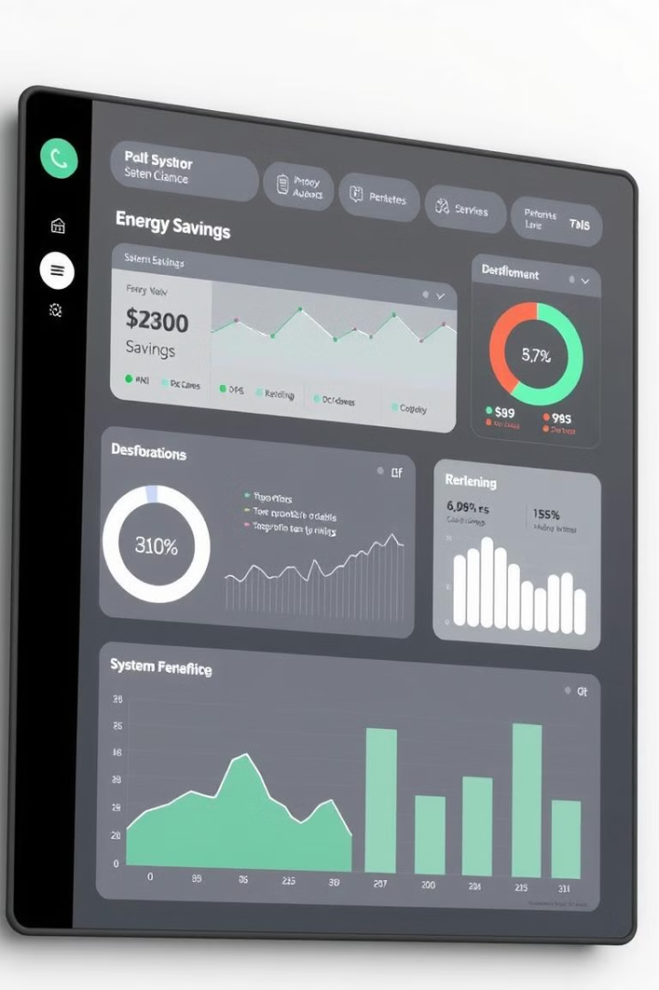
System Performance Metrics
30%
25%
Energy Savings
Cost Reduction
Average reduction in energy consumption.
Decrease in monthly electricity bills.
The system demonstrates significant energy savings, cost reduction, and high accuracy in occupancy detection. These metrics highlight the effectiveness and reliability of the smart energy-saving system.

Slide 11
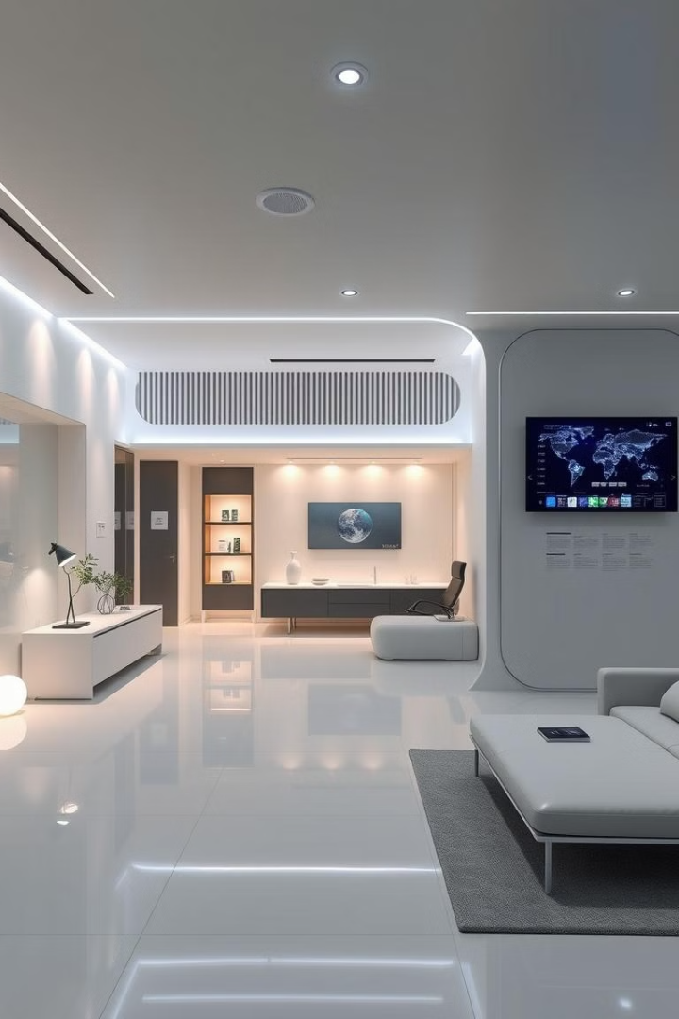
Conclusion
This smart energy-saving system efficiently manages room appliances by monitoring occupancy in real-time. It is a practical, cost-effective, and eco-friendly solution for smart homes, offices, and public buildings, contributing to a sustainable future.
By automating appliance control based on occupancy, the system reduces energy wastage, lowers electricity bills, and promotes sustainable energy use. Its versatility and effectiveness make it a valuable addition to any modern building.

Slide 12
THANK YOU

